Slide 1
Growth Theory
12
Notes:
Pre-class music: “We Are the World” by USA for Africa (See Tip #430)
USA for Africa sought to raise money to aid those hit by famine in Ethiopia (1983–1985) that claimed an estimated one million lives. In total, along with the Hands across America benefit event, USA for Africa raised almost $100 million. This song, which was written by Michael Jackson and Lionel Richie, and which features other notable 1980s celebrities (such as Bruce Springsteen, Stevie Wonder, and Bob Dylan), is therefore a good introduction to the key concept of foreign aid.

Slide 2
Previously
Economic growth is central to modern macroeconomics and helps us understand how living standards might be improved.
Only recently have standards of living improved.
Changes in per capita real GDP affect welfare.
Factors that contribute to economic growth:
  Resources
  Technology
  Institutions

Slide 3
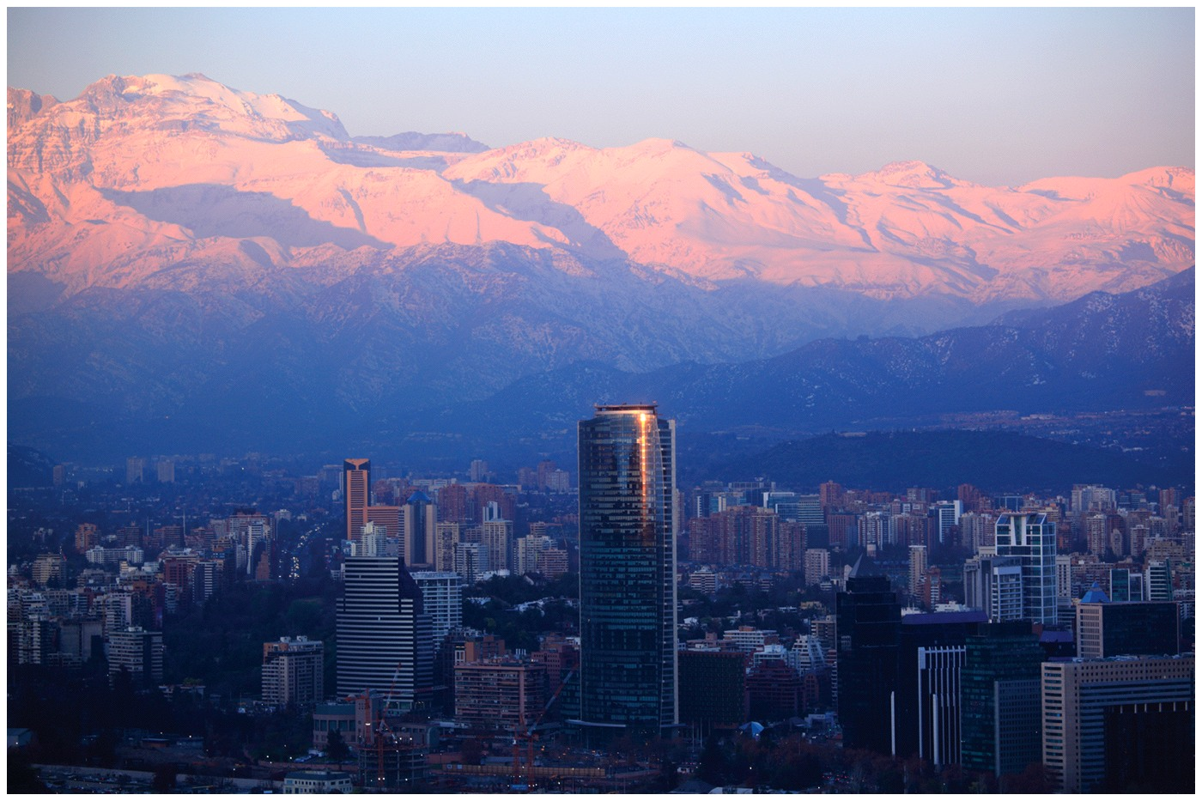
Big Questions
How do macroeconomic theories evolve?
What is the Solow growth model?
How does technology affect growth?
Why are institutions the key to economic growth?

Slide 4
Solow Growth Model
Sources of economic growth:
  Resources
  Technology
  Institutions
Growth theory started almost 60 years ago with Robert Solow
The Solow model still forms the basis of growth theory, but the theory has changed significantly over the past two decades
Notes:
Lecture notes:
Economic growth theory and policy have significant impacts on human lives.
Getting the best answers to growth questions really matters.
Economists have studied many factors that may contribute to economic growth.
There is a fundamental consensus among economists with regard to the factors necessary for growth.
The factors with the most robust relationship to growth are resources, technology, and institutions.
This consensus is the result of growth theory that started almost sixty years ago with Robert Solow and the Solow growth model.

Slide 5
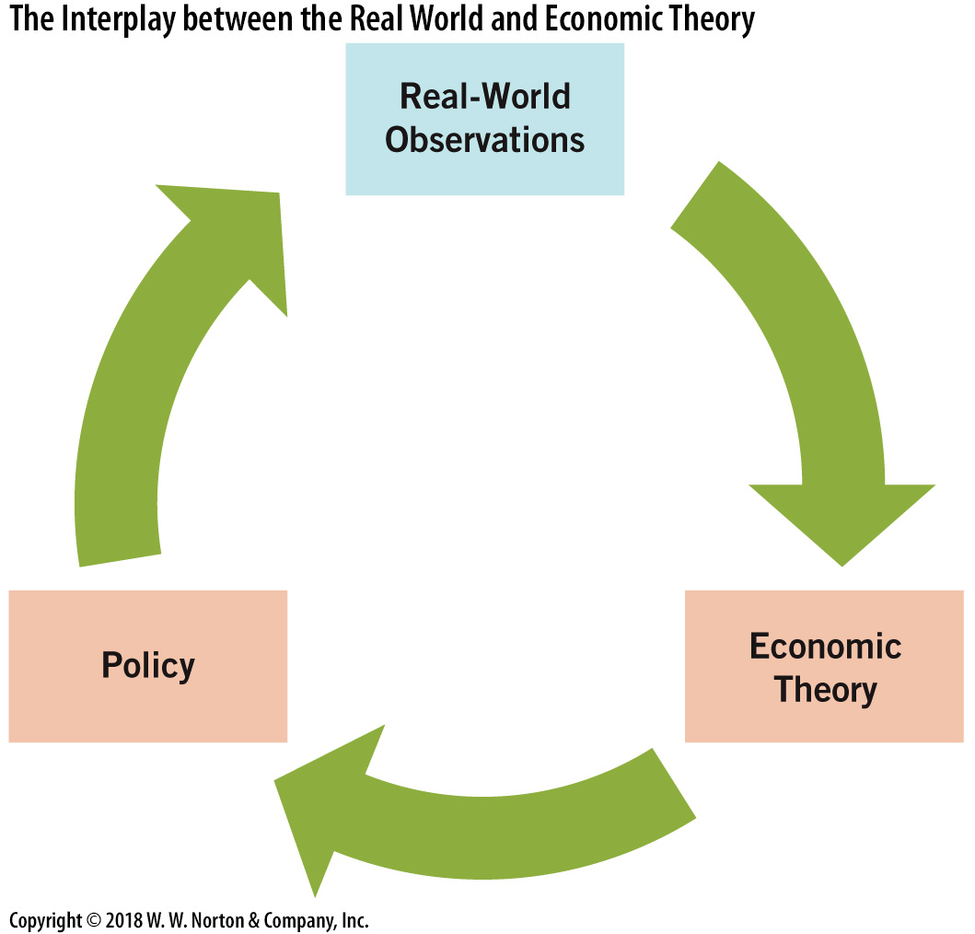
Interplay between Real World and Economic Theory
Notes:
Image: Figure 12.1
Lecture notes:
In many academic disciplines, new ideas and theories spark intellectual debates.
In economics, many of the theories are put to the test in the real world.
For example, John Maynard Keynes’ ideas were implemented immediately by FDR.
Solow’s ideas about growth were also acted on immediately.
In economics, ideas → policy → welfare effects.
The chart on this slide shows the cycle of relationships between theory, empirical data, and policy.
It’s a cycle because the theories are always being reworked as a result of seeing the policies in action and how they affect real-world data.
Policymakers must often convince the people (voters) that they are trying to help, especially during difficult times.
When the economy is in the trough of a business cycle (low or negative growth, high unemployment), politicians look to economists for advice on how to help the economy recover.
Often, economic theory is turned into policy quickly.
Historically, this has sometimes failed, as some theories were incomplete or erroneous.
From the text:
This is both good news and bad news for growth theory.
The good news is that growth theory is important enough to impact the welfare of billions of people around the world.
The bad news is that growth theory is important enough to impact the welfare of billions of people around the world. That is, if growth theory is wrong or incomplete, it can lead to faulty policy prescriptions and these policies may result in continued poverty for millions.

Slide 6
Solow I: Capital—1
Production function
  Relationship between inputs and output
  For the macroeconomy, output is GDP
Equation form:
  where,
  K: physical capital
  HK: human capital
  L: natural resources
Notes:
Lecture notes:
Regarding the equation:
“F” denotes a mathematical “function.”
K: physical capital
HK: human capital
L: natural resources
You can read this equation as: “GDP is a function of land, labor, and capital inputs.”
or “Output is a function of inputs.”
The equation communicates the idea that GDP in any country depends on the resources available for production.
All else being equal, more workers (labor and human capital) means more production.
Additionally, more tools (physical capital) and natural resources (land and others) also leads to more output
Resources matter!

Slide 7


Focus on Physical Capital
The first version of the Solow model focused on capital (rather than resources or labor).
Reasoning:
  Increasing tools available can increase output per worker
  Capital in wealthy nations exceeds capital in developing nations
  Periods of investment growth are periods of expansion
Notes:
Lecture notes:
The early Solow models focused on the availability of capital goods (much like the castaway example on slides 10 and 11).
First, based on theory, more physical capital available means more production.
Second, it is observed that the capital stock in wealthy nations is higher than that in developing nations.
Third, the data show that investment is usually increasing during periods of expansion.
All of these reasons appear to point to capital and investment as the primary source of growth.
Image on the left: Malaysia
Image on the right: Uganda

Slide 8
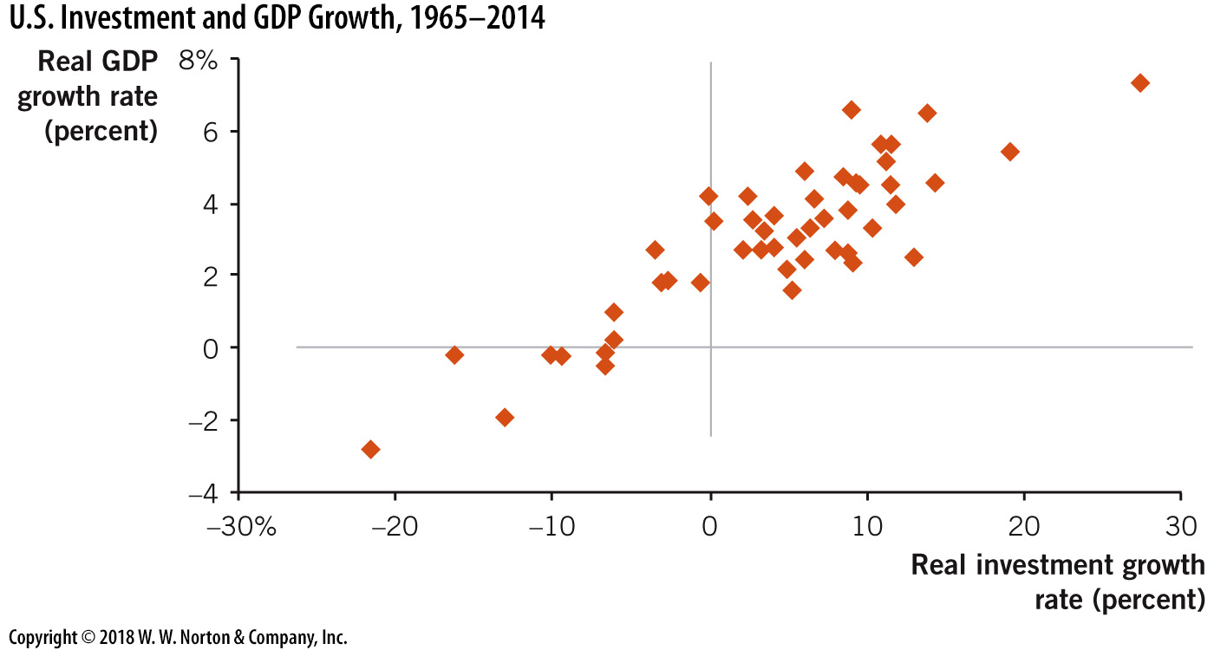
U.S. Investment and GDP Growth, 1965–2014
Notes:
Image: Figure 12.2
Lecture notes:
Growth in real investment is positively correlated with growth in real GDP.
If you were to draw a trend line through these data points, it would be upward sloping.
However, it is unclear from the chart above whether this implies causation and in which direction.
Lecture tip: This is a good time to remind students that correlation does not always imply causation.
Interpreting correlation as causal can be very misleading and lead to inaccurate conclusions and ineffective policies.
See http://www.tylervigen.com/spurious-correlations for some fun examples of spurious correlations.
Source: http://www.tylervigen.com/spurious-correlations

Slide 9
Solow I: Capital—2
Recall:
Marginal product (MP)
  Change in output divided by change in an input
    MP_{physical capital} > 0
    MP_{human capital} > 0
    MP_{natural resources} > 0
  Increasing inputs will increase output
Notes:
Lecture notes:
There is a marginal product for each input.
The three inequalities are implicitly stating a “ceteris paribus” assumption of just adding the one input while holding the others constant.
The MP of each input is positive.
If we add more of any input, output will increase.
Lecture tip: For students who are mathematically inclined, you can mention that the marginal product is the partial derivative of Y with respect to a particular input.

Slide 10
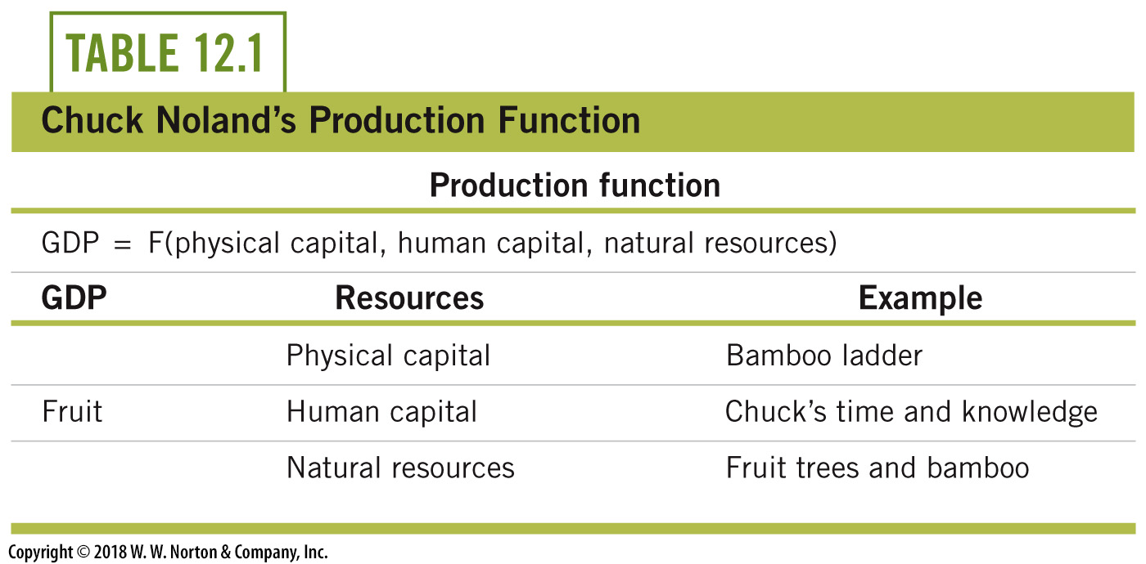
Simple Example:
Castaway on an Island—1
Notes:
Lecture notes:
From the text:
Consider a situation in which there is only one person in the macroeconomy— for example, the character Chuck Noland (played by Tom Hanks) in the 2000 movie Cast Away who finds himself stranded on an island in the South Pacific after his plane crashes.
In this case, Chuck’s individual, or microeconomic, decisions are also macroeconomic decisions, because he is the only person in the economy.
The GDP of Chuck’s island includes only what he produces with his resources.
Suppose Chuck spends his days harvesting fruit on the island.
That is, GDP = fruit Chuck harvests.
Table 12.1 shows Chuck’s production function and some of the resources he has available.
All else being equal, the more Chuck has of any of these resources, the more GDP he can produce.
Economic growth occurs if Chuck produces more fruit per week.

Slide 11

Simple Example:
Castaway on an Island—2
A ladder will help gather fruit
  Will adding a second ladder help?
    Yes
  Will the second ladder increase fruit production as much as the first ladder did?
    No. This is related to the principle of
    diminishing marginal productivity.
MP > 0, however…
  A resource’s MP declines as the quantity of the resource increases.
Notes:
Lecture notes:
From the text:
Chuck Noland would be happy if he found a new grove of mangoes on his island, and his newfound resources would increase his GDP.
Resources also help actual macroeconomies.
For example, the discoveries of natural gas in the United States have increased dramatically over the past two decades.
This new energy resource has enabled the United States to produce more with cheaper resources, because natural gas is less expensive than crude oil.
To quantify how helpful a resource may be, economists employ the concept of marginal product.
The marginal product of an input is the change in output associated with one additional unit of an input.
More resources increase output, so we say the marginal product of each resource is positive.
A second ladder is helpful (maybe it means he does not have to carry the ladder to the fruit groves on the other side of the island).
But the marginal product of the second ladder is smaller than that of the first.
Lecture tip:
The next slide shows the numbers and a graph.

Slide 12
Production Function:
Table and Graph
Notes:
Image: Animated Figure 12.3
Lecture tip:
Click through the slide for each part of the graph to appear.
Lecture notes:
A hypothetical relationship is presented in the table on the left side of Figure 12.3.
Chuck produces GDP by climbing trees and picking fruit.
With no ladders (physical capital), Chuck picks one bushel of fruit per week.
Then Chuck decides to build a bamboo ladder.
Building the ladder is a costly investment because it takes him away from producing fruit for a whole week.
Now, focus on the impact of Chuck’s first ladder: a single ladder enables Chuck to pick four bushels of fruit per week.
This means the marginal product of the first ladder is three bushels per week:
MP_{Capital} = ∆GDP/∆Capital = 3.
Perhaps Chuck decides to build more ladders.
Assume the marginal product of the second ladder is two bushels per week, so that with two ladders, Chuck can harvest six bushels of fruit per week.
Notice also that a third ladder helps produce more output, but the marginal gain declines to just one bushel of fruit.
The marginal product of the second ladder is not as large because while the first ladder completely altered the way Chuck harvests fruit, the second ladder just makes his job a little easier.
Notice that the marginal product per ladder declines as more ladders are added.
This outcome reflects the principle of diminishing marginal product, which states that the marginal product of an input falls as the quantity of the input rises.
Diminishing marginal product generally applies across all factors of production at both the microeconomic and the macroeconomic levels.
Notice the slope of the curve flattens out because the marginal product of the added ladders diminishes.
This principle of diminishing marginal productivity is not special to our example of one man alone on an island.
It is a phenomenon that holds for resources in a macroeconomy in general, and it is a cornerstone insight of the Solow growth model.

Slide 13

The Eisenhower Interstate Highway System
Notes:
Lecture notes:
The image on the slide is a real-life example of diminishing marginal product of capital (MPK).
From the text:
The network of highways connects the major cities of the United States.
The highways enhance our ability to transport goods and services across the nation.
For example, a couch manufactured in High Point, North Carolina, can be transported exclusively by interstate highway to Cleveland, Ohio, in less than eight hours (mostly via I-77).
Before the construction of the interstate system, the same trip between High Point and Cleveland would have entailed driving on several state highways, often with only two lanes and including traffic lights.
Our system of highways is a major tool that contributes to our GDP.
If the interstate highway system were somehow closed down completely, GDP would immediately fall.
On the other hand, how useful would we find an additional network of 50,000 miles of interstate highways? That is, what is the marginal product of an additional interstate highway system?
The impact would certainly be positive.
But, just as certainly, the impact would fall short of the positive impact of the first (existing) network.

Slide 14
Aggregate Production Function
Notes:
Image: Animated Figure 12.4
Lecture tip:
Click through the slide for each part of the graph to appear.
Lecture notes:
The figure on the slide is a picture of a general production function for a macroeconomy.
On the vertical axis, we have output or real GDP (Y).
On the horizontal axis, capital resources (K) increase from left to right.
Notice that the slope of the function is positive, which indicates positive marginal product.
But the slope is also decreasing at higher levels of capital, and this indicates the diminishing marginal product of capital.
For example, the slope at K₃ is not as steep as the slope at K₂. This indicates that increases in the level of capital have less of a positive effect on output (Y) at K₃ than at K₂.
In this graph, we hold fixed all other factors that influence output (land and labor).
The important theoretical contributions at this stage are that the marginal product of capital is positive and declining.
This leads to striking implications for the macroeconomy.
The figure forms the basis for most discussions in growth theory since 1956.
Economic growth is represented by movements upward along the vertical axis.
Indeed, if we focus only on this simple formulation, the way we get economic growth is through investment, which leads to more capital.

Slide 15
Practice What You Know—1
According to the idea of diminishing marginal product, where will capital have the highest marginal productivity?
  in countries with a large amount of labor
  in countries with a small amount of labor
  in countries with a large amount of capital
  in countries with a small amount of capital
Notes:
Clicker question:
Correct answer: D, in countries with a small amount of capital
Diminishing MP says that if there is already a large amount of an input, additional inputs of that type will have lower MP.
Adding capital where there is very little or no capital will greatly increase productivity at the margin.

Slide 16
Two Theoretical Implications—1
Steady states
  A long-run equilibrium point in which there is no new investment
    There is no change in capital stock or real income at this point
  Since MPK decreases, there eventually will be no positive net return to more investment, even if the cost of capital is zero.
  There is no incentive to invest if the cost of investment is greater than the return on investment.
Notes:
Lecture notes:
In reality, capital is costly and so capital will only be replaced when the benefits from additional units exceed the costs.
With positive costs of capital, this will happen at some point to the left of K₄ in the previous figure, perhaps at K₃.
You can think of the steady state as the “stagnant state,” because when the economy reaches its steady state, real GDP stops increasing.
Economic growth stops.
Back to the castaway example:
The castaway reaches his steady state when a new ladder is not worth the time it takes to build it.
So he stops building ladders (capital) and his income growth stops.

Slide 17
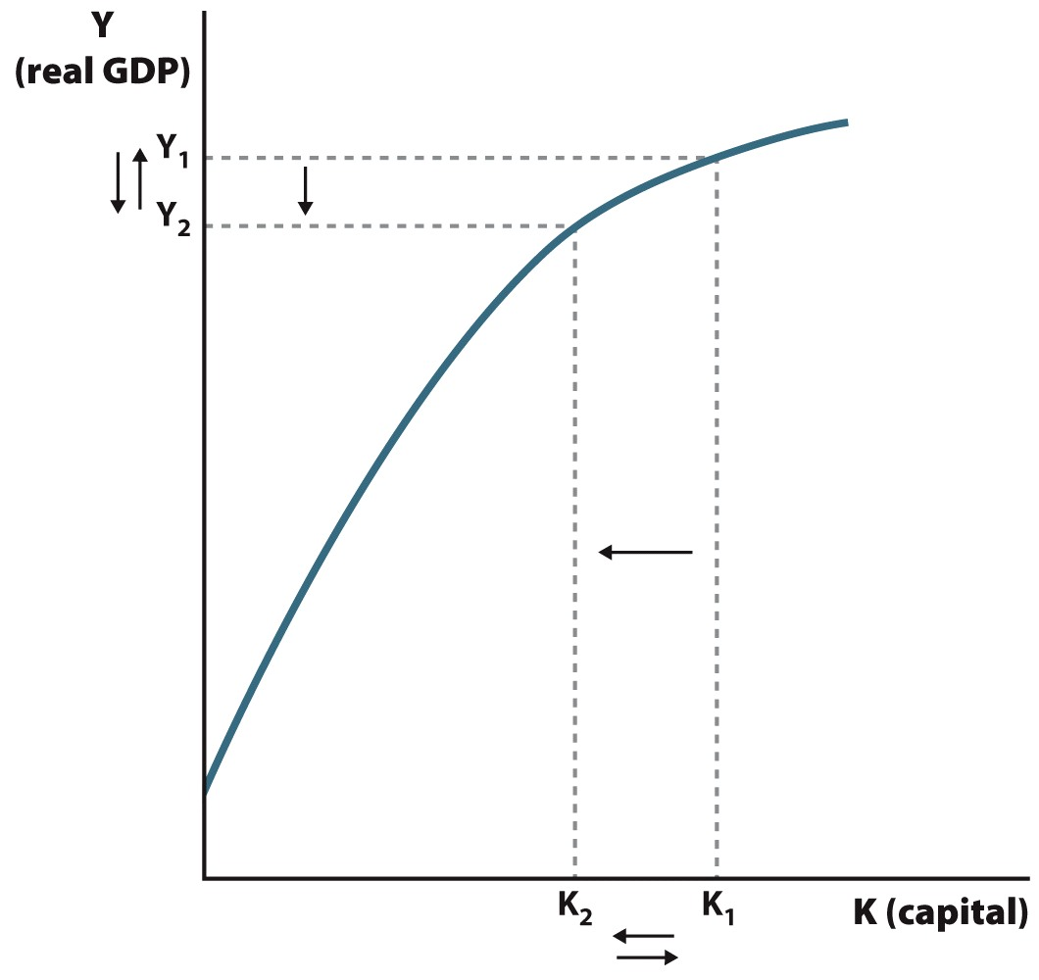
Changes in Resources: Natural Disasters
Notes:
Image: Aggregate Production Function to illustrate the way a major destruction of capital affects a macroeconomy in the short run (see the Practice What You Know: Changes in Resource: Natural Disasters feature).

Slide 18
Investment
Depreciation
  The fall in the value of a resource over time
    Factories become outdated
    Machines wear down
    Roads crumble
Net investment
  Investment minus depreciation
  To increase capital stock, net investment > 0
  In a steady state, there is no net investment
Notes:
Lecture notes:
Some positive investment is needed just to keep pace with depreciation.
But if investment is just sufficient to offset depreciation, the capital stock doesn’t increase and this means no net investment.

Slide 19

Two Theoretical Implications—2
Convergence
  Over time, per capita GDP across nations will equalize
Application of marginal product
  Developing nations should “catch up” quickly
    Lower levels of capital
    MPK should be higher
  Return on investment should be higher
Notes:
Lecture notes:
Theoretically, GDP per capita in developing nations should grow at a faster rate than developed economies.
If one nation reaches steady state, this does not necessarily mean all nations did.
In other words, countries with lower levels of GDP per capita should have higher growth rates of GDP per capita.
Developed economies in the past have already made new discoveries and documented mistakes to avoid in the development process.
Therefore, developing nations can benefit from these discoveries and avoid the same mistakes, allowing them to quickly develop the best equipment, tools, and practices.
For example, if a developing nation is building cars, they don’t have to start with a Model T and a basic labor-intensive assembly line.
Recall the concept of diminishing marginal product.
At lower levels of capital, the marginal product of capital (MPK) should be higher.
This also means that the return on investment should be higher.
If this is true, we would expect people to want to invest in developing countries rather than developed countries.
However, this is not as common as the model would suggest.

Slide 20
Convergence
Notes:
Image: Animated Figure 12.5
Lecture tip:
Click through the slide for each part of the graph to appear.
Lecture notes:
Consider a historical example.
In 1980, the United States had much more capital than China did.
This was one reason why real GDP for the United States was much higher.
But, in the years since, China has increased its capital stock substantially and has grown much more rapidly than the United States.
The Solow model implies that the United States is closer to its steady state and therefore grows more slowly than China.
If the two nations were identical except for their capital, China’s growth should converge to the U.S. output level.

Slide 21
Two Theoretical Implications—3
Does our model match the data?
  Is a factory in Haiti more productive than a factory in Germany?
  Are more people willing to invest in Haiti instead of the United States because of a higher expected rate of return?
Data show:
  Growth in wealthy nations outpaces poor countries
  No sign of convergence
Notes:
Lecture notes:
The theory of convergence implies that the answers to questions (1) and (2) are yes.
However, the data show little to no evidence of this being true.
Some poor countries have experienced rapid growth—China, South Korea, Singapore, India, Chile—but these are exceptions.
During the second half of the twentieth century, most developing countries have continued to stagnate instead of experiencing high growth rates.
In addition, most wealthy countries have still experienced strong growth rates, rather than slowing down.
Some countries have seen growth slow in recent decades (United States) but not enough to close the gap between the rich and poor countries.
In fact, we have seen more evidence of divergence, widening of the gap between the wealthy and poor countries, than convergence.
Obviously, there is something missing in the basic Solow model.
This is clear today, and it was clear in the 1950s.
The Solow model implies faster growth in developing nations, yet economic growth in wealthy nations often outpaces the poor ones.
Looking around the globe, it is clear that growth in developed nations has not stopped.
Therefore, economists have reevaluated the model of economic growth, identifying technology as a key determinant.

Slide 22
Capital and Growth
Capital appears to cause economic growth
  Strong correlation between wealth and output
  Workers are more productive with more tools
However:
  Capital alone is not enough to explain sustained growth!
  Need a more advanced version of the Solow model to explain economic growth
Notes:
Lecture notes:
The correlation between wealth and output could lead to misinterpretation of causality.
Perhaps wealth leads to more output or more output leads to greater wealth.
This concept is a little bit beyond the scope of this course but still worth identifying and discussing.
The issues with the Solow model motivated economists to develop a more sophisticated version.

Slide 23
Practice What You Know—2
The original Solow model focused on what as the main source of economic growth?
  labor
  education
  capital
  effective government
Notes:
Clicker question
Correct answer: C, capital
The original model basically said that for growth to occur, capital investment is necessary.

Slide 24


Solow II: Technology Matters—1
Increases in technology
  Produce more output with each input unit
  A zero-growth long-run equilibrium is avoidable
  Graphically, as MPK increases, the production function shifts upward
Notes:
Lecture notes:
Recall that technology refers to the knowledge that is available for use in production.
This version of the Solow model more accurately matches the data because change in technology means that growth can continue and a zero-growth long-run equilibrium is avoidable.
Graphically, an increase in technology shifts the MPK curve upward, but it won’t be a direct parallel shift.
Regarding the two images: These two capital units are at different technology levels.

Slide 25
Solow II: Technology Matters—2
Solow II equation:
  where “A” represents technology
Notes:
Lecture notes:
New technology means output is higher for any given level of capital.
The capital, which embeds the new technology, is more productive.
For example, personal computers today are much more productive than personal computers of even ten years ago.
The new Solow model production function includes a scalar (numerical constant) that allows for technological advancement.
In this equation, more technology will increase the value of “A.”
Augmenting the Solow model with A explains continued economic growth.
In the absence of new technology, the economy will eventually reach a zero-growth steady state.
However, with new technology, for any given level of capital, output is higher.

Slide 26
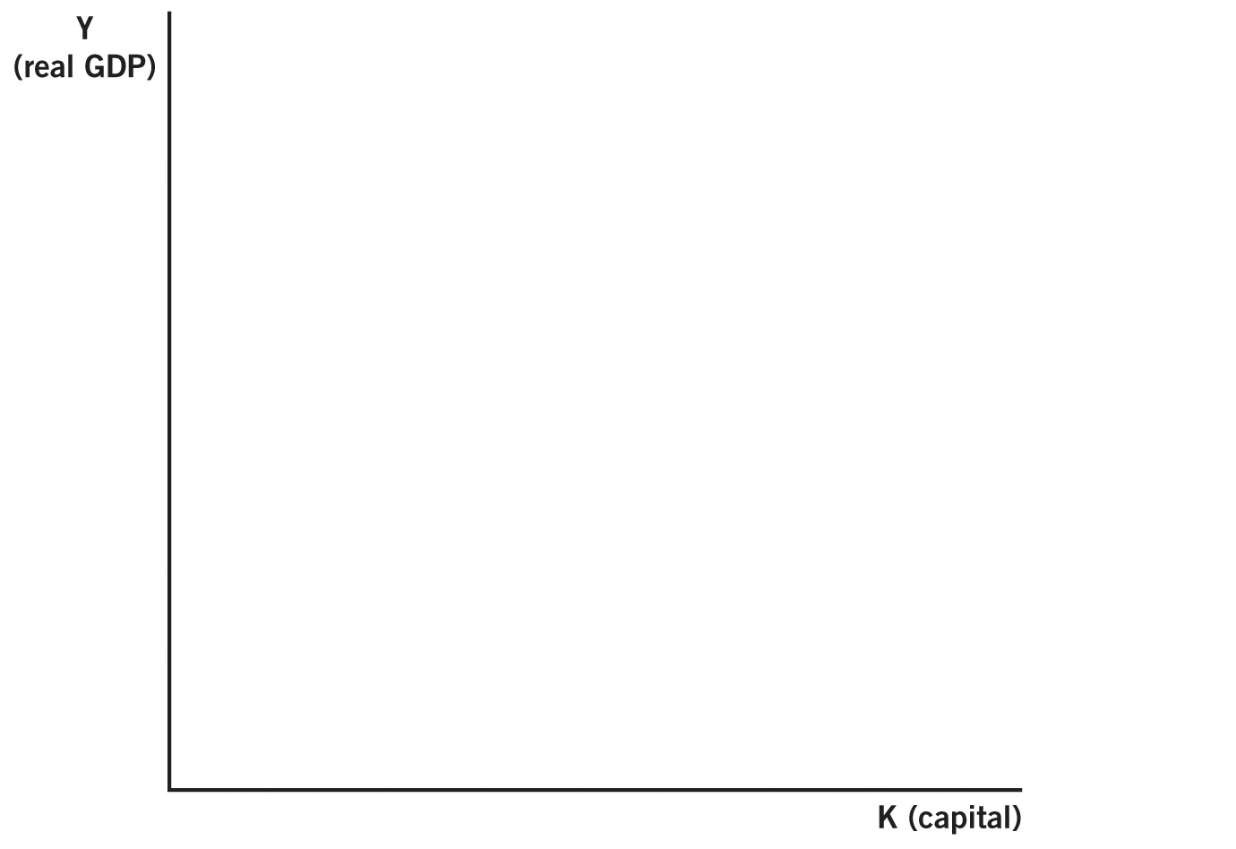
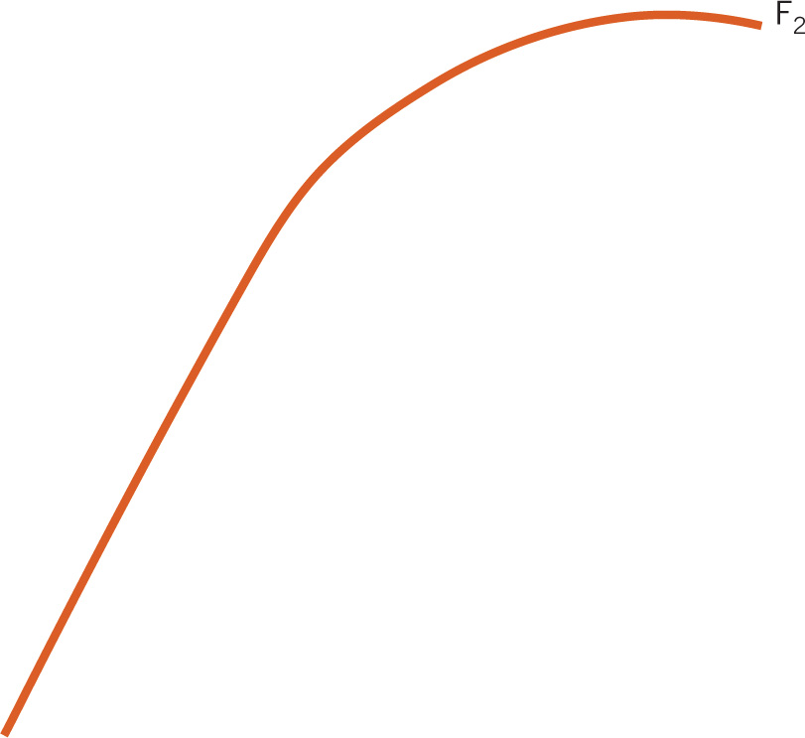
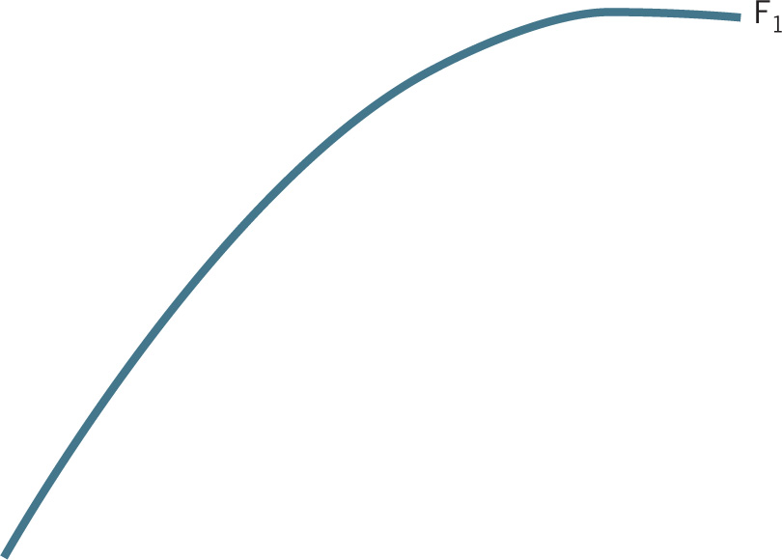
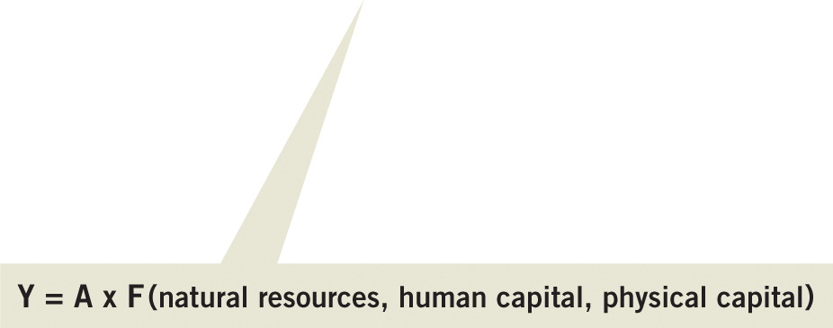
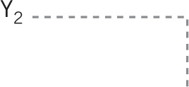
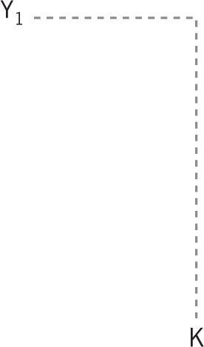
Solow II: New Technology
Notes:
Image: Animated Figure 12.6
Lecture tip:
Click through the slide for each part of the graph to appear.
Lecture notes:
The figure on the slide shows an economy’s production function with changes in technology.
F₁ is the original production function and F₂ is the production function after a technological advancement.
The slope of the F2 production function is steeper at all points, given that technological advancement means each unit of capital adds more to output than in the past.
Recall, the slope of the production function is dictated by the marginal product of capital.
In economic terms, a technological innovation increases the marginal product of each unit of capital.
The curve shifts upward, but the shift is not a parallel shift.
Increases in technology will lead to sustained economic growth.

Slide 27
Practice What You Know—3
In the second Solow model, how were technology advances modeled?
  Technology depended on institutions in the country.
  Technology was fixed over time.
  Technology shocks were considered random and exogenous.
  Technology grew at a steady rate for most countries.
Notes:
Clicker question:
Correct answer: C, Technology shocks were considered random and exogenous.
If prices and wages both change at the same rate, nothing changes in real terms. However, they both went up, so that is a nominal (nonadjusted) increase.
Exogenous = occurs from the outside.

Slide 28
Variations of the Solow Model
Effective labor
  More education shifts the production function upward
Population control
  Per capita GDP is higher if we have fewer people
Geography
  Land resources: access to trade routes
Medicine
  Access to health care can increase productivity
Notes:
“Beyond the Book” Slide
Lecture notes:
These are variations on the idea that economic progress derives exclusively from resources and technology.
When treated like capital, an increase in human capital (education) has similar effects to technological advances—the production function shifts upward.
The larger the population, the larger the value of the denominator and smaller the value of GDP per capita (holding all else constant).
The direction of causality between access to health care and GDP growth is difficult to assess.
While health care and GDP are correlated, it is less clear whether increases in health care cause higher levels of GDP or vice versa.
Lecture tip:
Here are some additional resources that present an overview of empirical economic growth, determinants of country-level economic growth.
Levine, Ross, and David Renelt. "A sensitivity analysis of cross-country growth regressions." The American Economic Review (1992): 942-963.
Mankiw, N. Gregory, David Romer, and David Weil. "A Contribution to the Empirics of Economic Growth." The Quarterly Journal of Economics (1992).
Barro, Robert J. "Determinants of economic growth in a panel of countries." Annals of Economics and Finance 4 (2003): 231-274.
Barro (2003) provides a good representation of the literature.
Explaining long-run variation in growth usually involves omission of variables that affect the short run (such as money).
Results vary depending on such things as:
Countries included in the analysis
Time frame
Methodology
Omitted variables
Variable definitions
Nonlinearities
Some factors that have a significant impact on economic growth:
Initial GDP
Human capital
Life expectancy
Fertility
Government consumption
Rule of law
Democracy
Openness
Terms of trade
Investment
Inflation

Slide 29
Exogenous Technical Change
Assumption of exogenous technology shocks
  Technology increases just “happen” to hit
    Nothing in the economy produces the change
  Until the 1980s when new models incorporated technological change into the model (endogenous)
Two reasons for this assumption:
  Technological progress often is lucky and random
  Made the theoretical models easier to solve
Notes:
Lecture notes:
The assumption basically was that innovation occurred in wealthy nations, but not because of any inherent characteristics.
Similarly, poor nations are poor simply because the random technology shocks happened elsewhere.
Developed nations won the technology lottery.
Economic models are developed mathematically, for better or worse, and need simplifying assumptions in order to be solvable.
Models of economic growth must include many interrelated factors and they get complex quickly.
“Endogenous” would mean that current economic situations can drive more technology growth to occur.
If people have an incentive to make life better, they will try harder for new innovations.

Slide 30
Policy Implications of the Solow Growth Theory
Results of Solow
  Wealth comes from capital and technology
  Wealthy nations fund capital investment in poor countries
Two types of aid in the 1950s and 1960s
  Actual capital goods were built with aid
  Aid given to developing countries to fund infrastructure
Results of these policies
  Some countries received billions in aid and are no better off today than they were in 1960
  Some countries received almost no aid and have grown rapidly
Notes:
Lecture notes:
In 1964, the United States, Great Britain, and the World Bank funded building of the Akosombo Dam in Ghana.
The purpose of the additional infrastructure was to create hydroelectric power and a lake that could provide water transportation and development of a fishing industry.
In addition, aid was sent to developing nations in order to increase capital expenditures (such as highways, bridges, and modern ports).
Unfortunately, these efforts were largely unsuccessful at promoting economic growth.
For instance, almost fifty years after the dam was completed in Ghana, the average income level rose by only $300 per person.
Similar situations occurred in countries such as Zimbabwe, Liberia, Nicaragua, and Haiti.
These countries have similar levels of GDP per capita today as in 1960, despite billions of dollars of aid.
In contrast, some countries have received virtually no aid and yet have grown rapidly (for instance, Taiwan, Chile, China, and India).
The Solow model seems theoretically airtight.
Yet, direct application in the real world leads to woefully inadequate results.
Why are so many nations, after the guiding and direction of growth economics, still so poor?
Modern growth theory aims to answer this question.

Slide 31
Solow Case Study: Africa
From 1956 to 1977
  Thirty-seven African countries achieved independence
  Unique opportunity to apply the Solow model
  Heavy capital investment projects in Africa
Results
  Fifty years later, policies failed across the continent
  Why? Incomplete growth theory, faulty policy
  Observations led to a reexamination of growth theory
Notes:
Lecture notes:
The Solow model was initially developed in 1956 and was applied consistently to countries in Africa.
Newly independent nations provided an opportunity to apply the findings of the Solow model.
Over fifty years later, it is evident that many of the policies failed across the continent
Most African nations are no better off today compared to the 1950s, despite the fact that the developed world has experienced significant economic growth.
These empirical observations caused economists to reexamine growth theory in the late twentieth century.

Slide 32
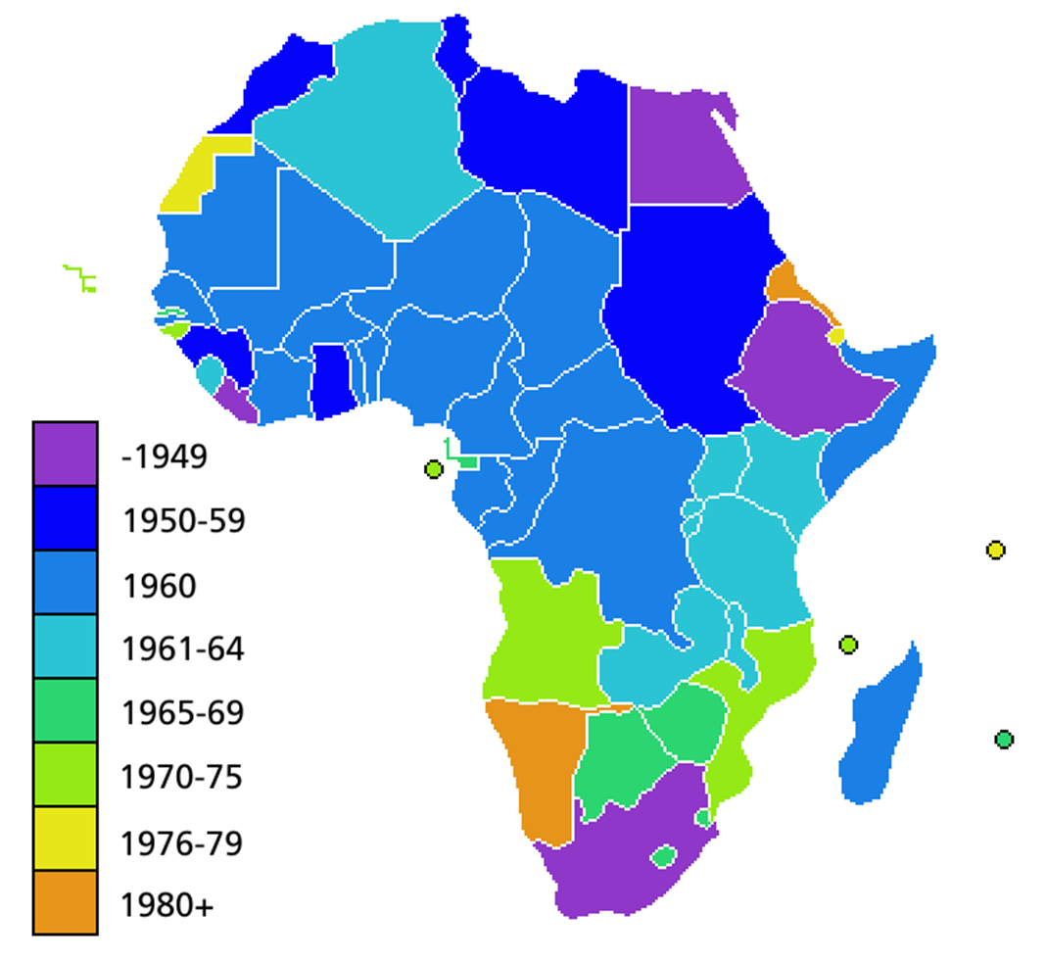
African Independence Dates
Notes:
”Beyond the Book” Slide

Slide 33
Modern Growth Theory
Modern growth theory
  Some economies grow faster for reasons specific to those economies
  Technological change is now considered endogenous
    Create an environment that encourages technological change
Robert Lucas:
"Is there some action a government of India could take that would lead the Indian economy to grow like Indonesia’s or Egypt’s? If so, what exactly? If not, what is it about the “nature of India” that makes it so? The consequences for human welfare involved in questions like these are simply staggering: once one starts to think about them, it is hard to think of anything else."
Notes:
”Beyond the Book” Slide
Lecture notes:
Modern economic growth theory focuses on particular reasons that some nations experience technological advancement while others do not.
Growth is sustained through technological innovation that occurs endogenously, driven by factors inside the economy.
Technological innovations no longer occur randomly (exogenously).
Robert Lucas is a Nobel Prize-winning macroeconomist.
Here is why it matters for policy: if technological change is based on pure randomness, there’s not much we can do to encourage natural growth.
On the other hand, if technological change is caused by factors inside the economy (endogenous), we can influence growth by trying to change the economy so it fosters technological advances.

Slide 34
Economics in Modern Marvels, “Harvesting 2”
Modern Marvels (History Channel)
  This episode features technological advancements in the food production industry.
  Technology and mechanization can produce food cheaper.
Notes:
”Economics in Media” Slide
Lecture tip:
The clip mentioned on the slide can be found in the Interactive Instructor’s Guide. Access the direct link by clicking the icon in the PowerPoint above.
Note: This is a long video. You may want to “time stamp” some clips to figure out what parts you want the students to view.

Slide 35
Practice What You Know—4
How does modern growth theory model technology and technological change?
  Technology change is endogenous and depends on factors that currently exist in the economy.
  Technology changes faster in less-developed countries and convergence will occur.
  Technological advances occur at faster rates with a stronger government.
  Technology grows exponentially.
Notes:
Clicker question:
Correct answer: A, Technology change is endogenous and depends on factors that currently exist in the economy.
Modern growth theory realizes that institutions have an effect on how technological progress and innovation occur.
Thus, technology is now endogenous, meaning it depends on the current state of an economy.

Slide 36
Institutions—1
Institutions:
  Significant practices, relationships, or organizations in society that frame the incentive structure within which individuals and business firms act
Notes:
Lecture notes:
Proper institutions can create the incentive for growth.
Institutions can be formal or informal; dictate the production environment; and help determine the costs and benefits of production.
Different institutions can create different incentives for individuals and change their behavior, which can promote or hinder growth.
Broadly defined, we could have good institutions and bad institutions.
These were discussed in the previous chapter at length.

Slide 37
Institutions—2
The right institutions lead to economic growth
  Positive institutions: transparent and consistent government, private property rights, stable money and prices
  Negative institutions: corruption, political instability
Notes:
Lecture notes:
Modern growth theory augments the traditional Solow model.
The aggregate production function is still the foundation of all growth theory.
Note the change in the production function.
We have added a fourth variable, laying the foundation for endogenous growth.
Many economists have started to recognize the role of strong institutions in growth.
Institutions provide incentives for new technology and growth to emerge.

Slide 38
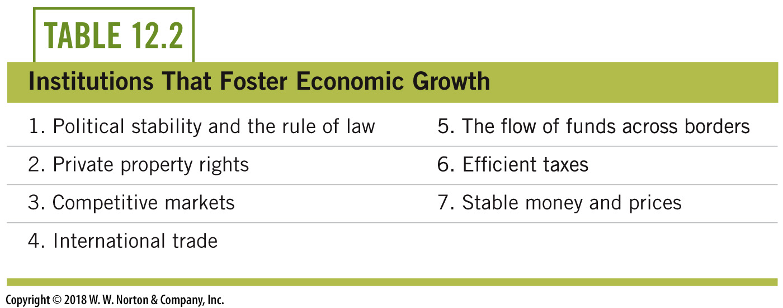
Institutions that Foster Economic Growth
Notes:
Lecture tip: The table on this slide, table 12.2, lists the institutions that are important for growth.

Slide 39

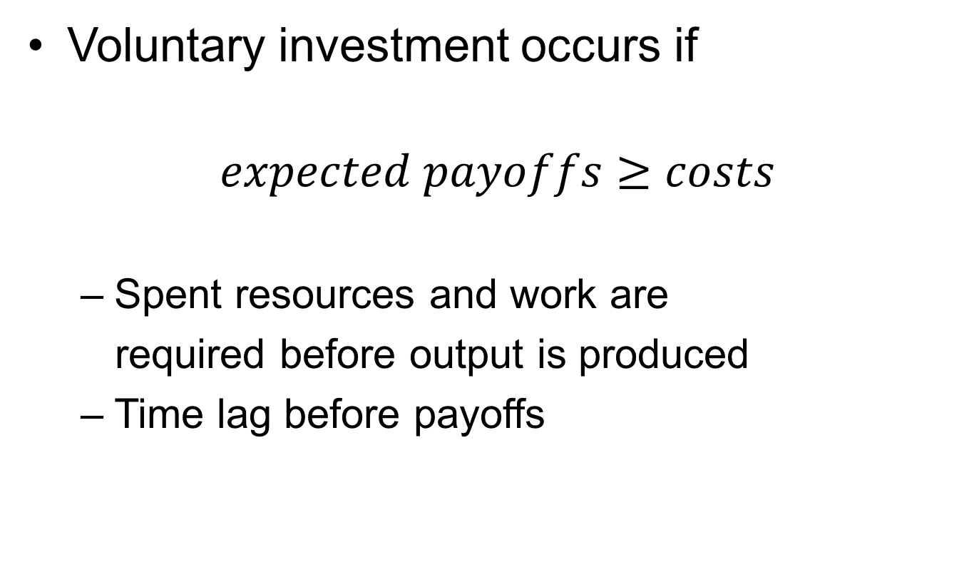
Institutions Determine Incentives—1
Voluntary investment occurs if
$$expected payoffs≥costs$$
  Spent resources and work are
  required before output is produced
  Time lag before payoffs
Notes:
Lecture notes:
How do institutions affect production decisions?
Investment occurs if the expected payoffs are greater than the costs.
Payoffs for production occur with a time lag, the value of which depends on the type of output produced, while costs are usually paid up front.
Because of the delay and the resources required, firms need to believe that the sacrifice, patience, and effort will offer a real payoff in the future.
Regarding the image of the sprouted seed:
This is a representation of a time lag.
Often, payoffs from today’s investment come a long time in the future.
We are sometimes not patient enough for this investment!

Slide 40
Institutions Determine Incentives—2
Investment and production occur naturally under certain conditions
  Example:
    Decision whether or not to attend college
    Believe that your degree will result in higher wages above the cost of tuition and the opportunity cost of 4 years’ income
  Voluntary investment in human capital
Notes:
Lecture notes:
Consider your individual decision whether or not to invest in human capital (attend college).
Human capital is the skills, abilities, and training you possess as an individual.
You are voluntarily spending time and resources on acquiring human capital.
Reason: You expect the return on your investment in education will be greater than the cost of a college education.
College will increase general training, and often you will receive more specific on-the-job training when you gain employment.
So while you exert hard work today (going to classes, studying) and spend money on resources (time, paying for tuition and fees, also the opportunity cost of NOT working today), the future payoffs (hoping you get a higher-paying job when you graduate with your degree) are greater.
Investment and production occur naturally if future payoffs are significant and predictable—that is, if the incentives for investment and production are strong enough.
Incentives are dependent on a nation’s institutions.

Slide 41
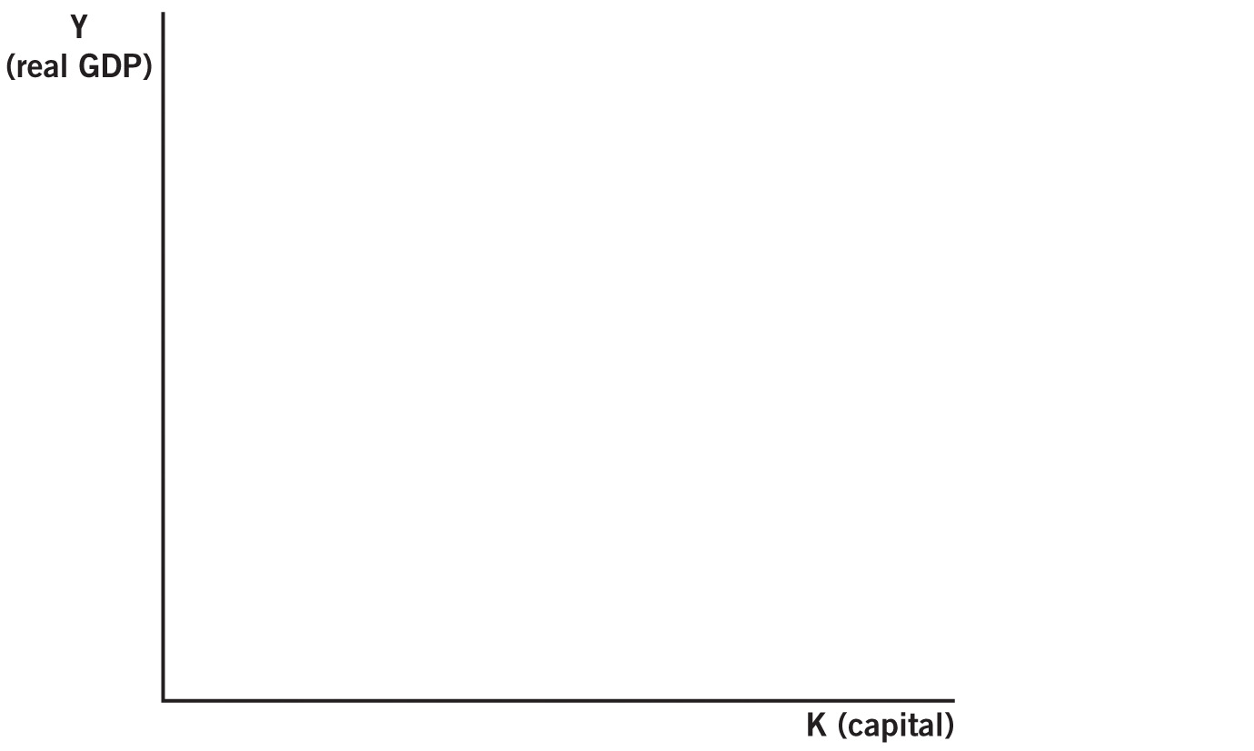
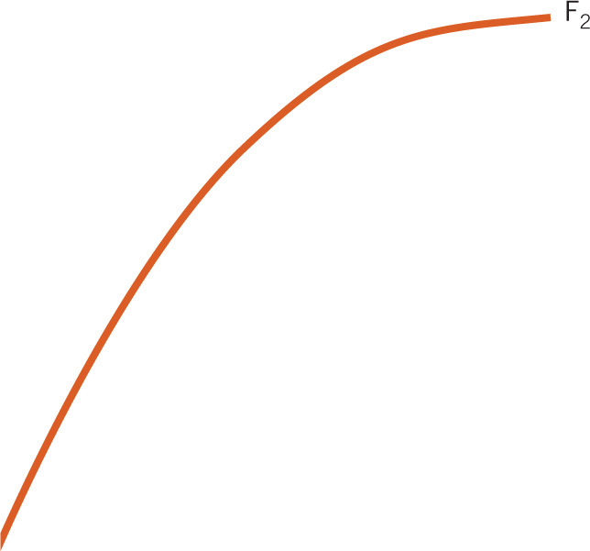

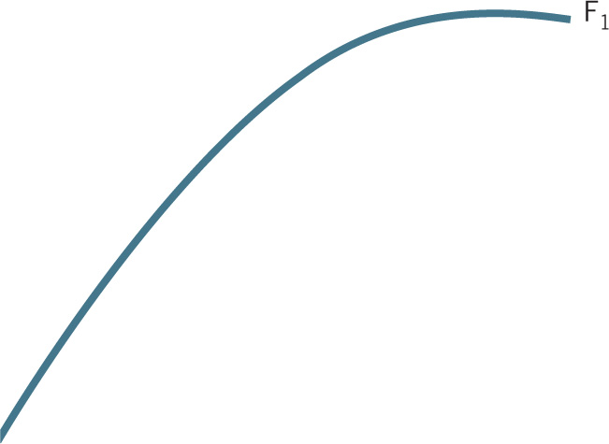
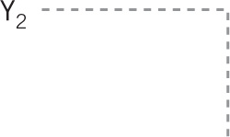
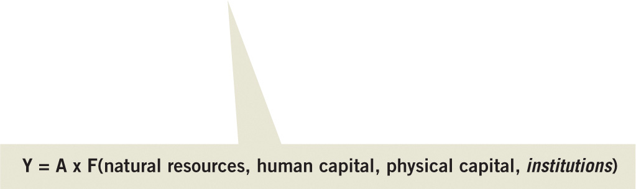

Institutions, Incentives, and Economic Growth
Notes:
Image: Animated Figure 12.7
Lecture tip:
Click through the slide for each part of the graph to appear.
Lecture notes:
The goal is economic growth, but it all starts with institutions.
Institutions provide the incentives that motivate choices made by people in an economy.
The right institutions provide incentives for people to invent new technology and to invest in human and physical capital.
These actions lead to economic growth.
People must work and invest today in order to get payoffs from output in the future.
Inefficient institutions (such as political instability, corruption, inflation, and high tax rates) reduce the expected future payoffs and thus reduce the incentives for production.
Growth-fostering institutions are those that maximize expected future payoffs for producers.
Figure 12.7 shows the effect of institutions on the production function.
Positive institutions can shift the production function upward, increasing it from F₁ to F₂.
Now, for any given level of capital, output is higher.
For example, a nation securing private property rights (such as China since the 1980s).
Private property rights incentivize production, as firms now reap the returns on their investment.
This is part of the reason we have seen rapid growth in China recently.

Slide 42
Practice What You Know—5
Why are the proper institutions important for creating economic growth?
  People only work for higher standards of living when they are required to do so.
  Institutions spread the wealth around so people don’t have to work as hard.
  Institutions create the incentive structure in which growth can occur.
  Institutions force people to increase productivity.
Notes:
Clicker question:
Correct answer: C, Institutions create the incentive structure in which growth can occur.
With the right institutions, people are given the incentive to innovate and increase production.

Slide 43
Conclusion
The Solow growth model, emphasizing capital and technology, forms the foundation of growth theory.
  Steady states
  Convergence
Solow II emphasizes the role of technology.
  Exogenous technological progress
Modern growth theory
  Highlights institutions that foster endogenous growth
Notes:
Lecture tip:
You can conclude the lecture by reiterating the following points:
Theories about economic growth affect the lives of real people.
There is and should be a strong interaction between theory, policies, and empirical evidence.
Theories are converted to policies and evaluated based on empirical observations.
The first Solow model (formulated in the 1950s) looked at capital goods (and other resources) as the primary determinant of economic growth.
Real-world observations seemed to strengthen this approach as capital and investment are correlated with income and growth levels across the globe.
Two major implications of diminishing returns in the Solow model are steady states and convergence.
The second Solow growth model emphasizes technology as the source of continued growth, assuming that technical changes are exogenous.
Modern growth theory:
Modern growth theory was shaped by the failures of policy based on the Solow model.
Modern growth theory emphasizes the critical nature of institutions that foster growth.
In other words, if the right institutions are in place, growth occurs endogenously.

